Slide 1

DBMS SELECT Command

Slide 2
Clauses in Select Command
Clause | Description
WHERE | It specifies which rows to retrieve.
GROUP BY | It is used to arrange the data into groups.
HAVING | It selects among the groups defined by the GROUP BY clause.
ORDER BY | It specifies an order in which to return the rows.
AS | It provides an alias which can be used to temporarily rename tables or columns.

Slide 3
Operators
= Equal
> greater than
< less than
>= greater than equal to
<= less than equal to
!= not equal
Between : Between a certain range
LIKE: Search for Pattern(string)
In: to specify multiple possible values for a column.

Slide 4
S_id | S_Name | S_addr | S_Marks
001 | Shreya | Mumbai | 73
002 | Yash | Pune | 72
003 | Swami | Bangalore | 75
004 | Hrishab | Delhi | 78
005 | Jai | Chennai | 79

Slide 5
The BETWEEN operator selects values within a given range. The values can be numbers, text, or dates.
The BETWEEN operator is inclusive: begin and end values are included.
Select * from student where s_marks Between 75 and 80.
S_id | S_Name | S_addr | S_Marks
003 | Swami | Bangalore | 75
004 | Hrishab | Delhi | 78
005 | Jai | Chennai | 79

Slide 6
AND , OR , NOT operator
Select column1,column2
from table name
Where condition1 OR condition2
Select * from tablename
Where NOT condition

Slide 7
OR
Select * from stduents
Where city=‘Pune’ OR city=‘Mumbai’
S_id | S_Name | S_addr | S_Marks
001 | Shreya | Mumbai | 73
002 | Yash | Pune | 72
003 | Swami | Bangalore | 75
004 | Hrishab | Delhi | 78
005 | Jai | Chennai | 79

Slide 8
AND
Select * from students
Where country=‘INDIA’ AND city=‘Banglore’
S_id | S_Name | S_addr | S_Marks | Country
001 | Shreya | Mumbai | 73 | INDIA
002 | Yash | Pune | 72 | INDIA
003 | Swami | Bangalore | 75 | INDIA
004 | Hrishab | Delhi | 78 | INDIA
005 | Jai | Chennai | 79 | INDIA

Slide 9
NOT
Select * from Students
where NOT city=‘Pune’
S_id | S_Name | S_addr | S_Marks | Country
001 | Shreya | Mumbai | 73 | INDIA
003 | Swami | Bangalore | 75 | INDIA
004 | Hrishab | Delhi | 78 | INDIA
005 | Jai | Chennai | 79 | INDIA

Slide 10
Like operator
Select column1,column2
From table
Where column LIKE pattern

Slide 11
Like Operator
Description
Like ‘a%’
LIKE ‘%a’
LIKE’ _ _r%’
LIKE ’a_ _%’
LIKE ‘a%b’
Customer name starting with a
Customer name ending with a
Customer name where r is at 3rd position
Starting with a and having atleast 3 characters in length
Customer name starting with a and ending with b

Slide 12
Customer
id | Name | City
1 | Sarita | Pune
2 | Sushmita | Mumbai
3 | Sunita | Delhi
4 | Babita | Chennai

Slide 13
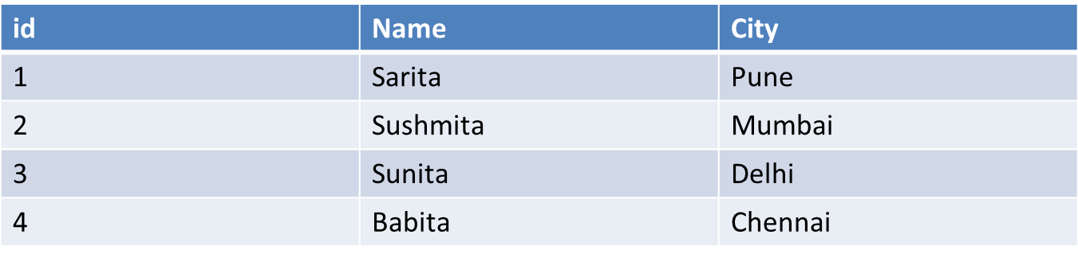
select name from customer
Where name LIKE’_ _ r%’

Slide 14
Select * from customer
Where name LIKE ‘%a’;
Select * from customer
Where name LIKE ‘s%’;

Slide 15
In operator
In operator allows you to specify multiple values in a where clause.

Slide 16
Select * from customers
where city In(‘Pune’, ‘Mumbai’, ’Delhi’)
id | Name | City
1 | Sarita | Pune
2 | Sushmita | Mumbai
3 | Sunita | Delhi

Slide 17
Select * from customers
Where city NOT IN (‘Mumbai’)

Slide 18
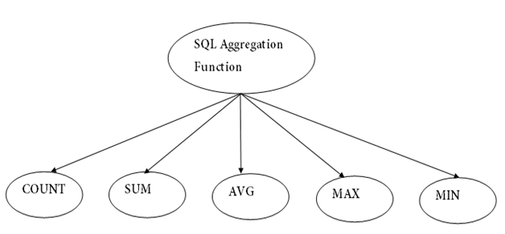
Aggregate functions

Slide 19
Min and Max Function
MIN(): Returns smallest value of selected column.
MAX(): Returns largest value of selected column.

Slide 20
Syntax
Select MIN(Column_name)
From table name
Where condition;
Select MAX(Column_name)
From table name
Where condition;

Slide 21
Prod_id | Price
1 | 10
2 | 20
3 | 30
Select MIN(Price)
From Product;
Select MAX(Price)
From Product;

Slide 22
Count(), Avg(), Sum()
Count() – used to count number of rows.
Avg() - returns average value
Sum()- Returns total sum

Slide 23
Select Count(Product_id)
From products;
Select avg(price)
From products;
Select sum(price)
From products;
Prod_id | Price
1 | 10
2 | 20
3 | 30

Slide 24
Prod_id | Price
1 | 10
2 | 20
3 | 30
Null | Null
Null values are ignored or not counted.

Slide 25
Order by
Sorts records in ascending order by default.
Select * from table_name
ORDERBY Column_name

Slide 26


Slide 27
Select * from customer
Order by city;
id | Name | City
4 | Babita | Chennai
3 | Sunita | Delhi
2 | Sushmita | Mumbai
1 | Sarita | Pune

Slide 28
Mention desc if you want descending order
Select * from customer
Order by city DESC;
id | Name | City
1 | Sarita | Pune
2 | Sushmita | Mumbai
3 | Sunita | Delhi
4 | Babita | Chennai

Slide 29
Group by
Group records in rows.
The GROUP BY statement groups rows that have the same values into summary rows, like "find the number of customers in each country".
It can be used with COUNT, AVG, SUM, MIN,MAX

Slide 30
syntax
Select column_name
From table_name
Where condition
Groupby column name

Slide 31
EG
Select id,count(city)
From student
Group by city;
id | Name | City
1 | Sarita | Pune
2 | Sushmita | Mumbai
3 | Sunita | Delhi
4 | Babita | Mumbai
5 | Rohan | Delhi
6 | Mohan | Mumbai

Slide 32
Count(city) | City
1 | Pune
3 | Mumbai
2 | Delhi

Slide 33
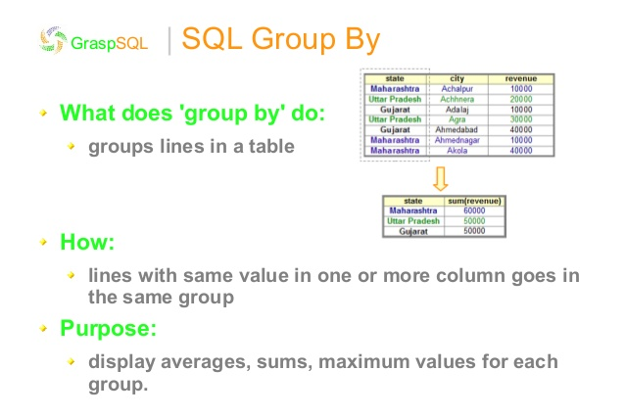

Slide 34
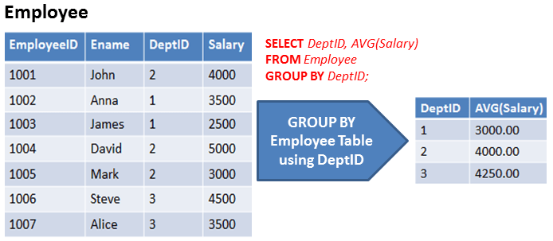

Slide 35
SELECT `gender` FROM `members` ;
gender
Female
Female
Male
Female
Male
Male
Male
Male
Male

Slide 36
SELECT `gender` FROM `members` GROUP BY `gender`;
gender
Female
Male

Slide 37
SELECT `gender`, COUNT(`membership_number`) FROM `members` GROUP BY `gender`;
gender | COUNT('membership_number')
Female | 3
Male | 5

Slide 38
Having
Having is used in the combination of Group by to restrict the groups of returned rows to only those whose the condition is true.

Slide 39
Select age,count(age)
From customers
Group by age
Having count (age)>=2;

Slide 40
Id | Name | Age | Addr | Salary
1 | Rohan | 25 | Mumbai | 10K
2 | Mohan | 22 | Pune | 12K
3 | Sohan | 25 | Banglore | 11k
4 | Sarita | 24 | Delhi | 16K
5 | Babita | 21 | Chennai | 11K
6 | Sunita | 20 | Mumbai | 10K

Slide 41
Count(age) | Age
2 | 25
1 | 22
2 | 21
1 | 20
Select age From customers Group by age
Count(age) | Age
2 | 25
2 | 21
Select age
From customers
Group by age
Having count (age)>=2;

Slide 42
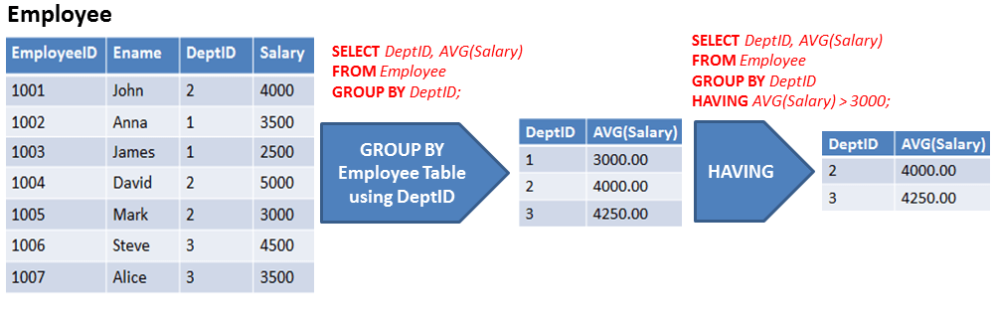

Slide 43
The GROUP BY Clause is used to group rows with same values .
The HAVING clause is used to restrict the results returned by the GROUP BY clause.

Slide 44
SQL Aliases
Used to give temporary name to table or table name.
Alias only exists for the duration of query.

Slide 45
syntax
Select column_name as alias name
from table name;
Eg:
Select Cust_id as ID , Customer_name as Name
from customer;

Slide 46
Thank you !

